Slide 1
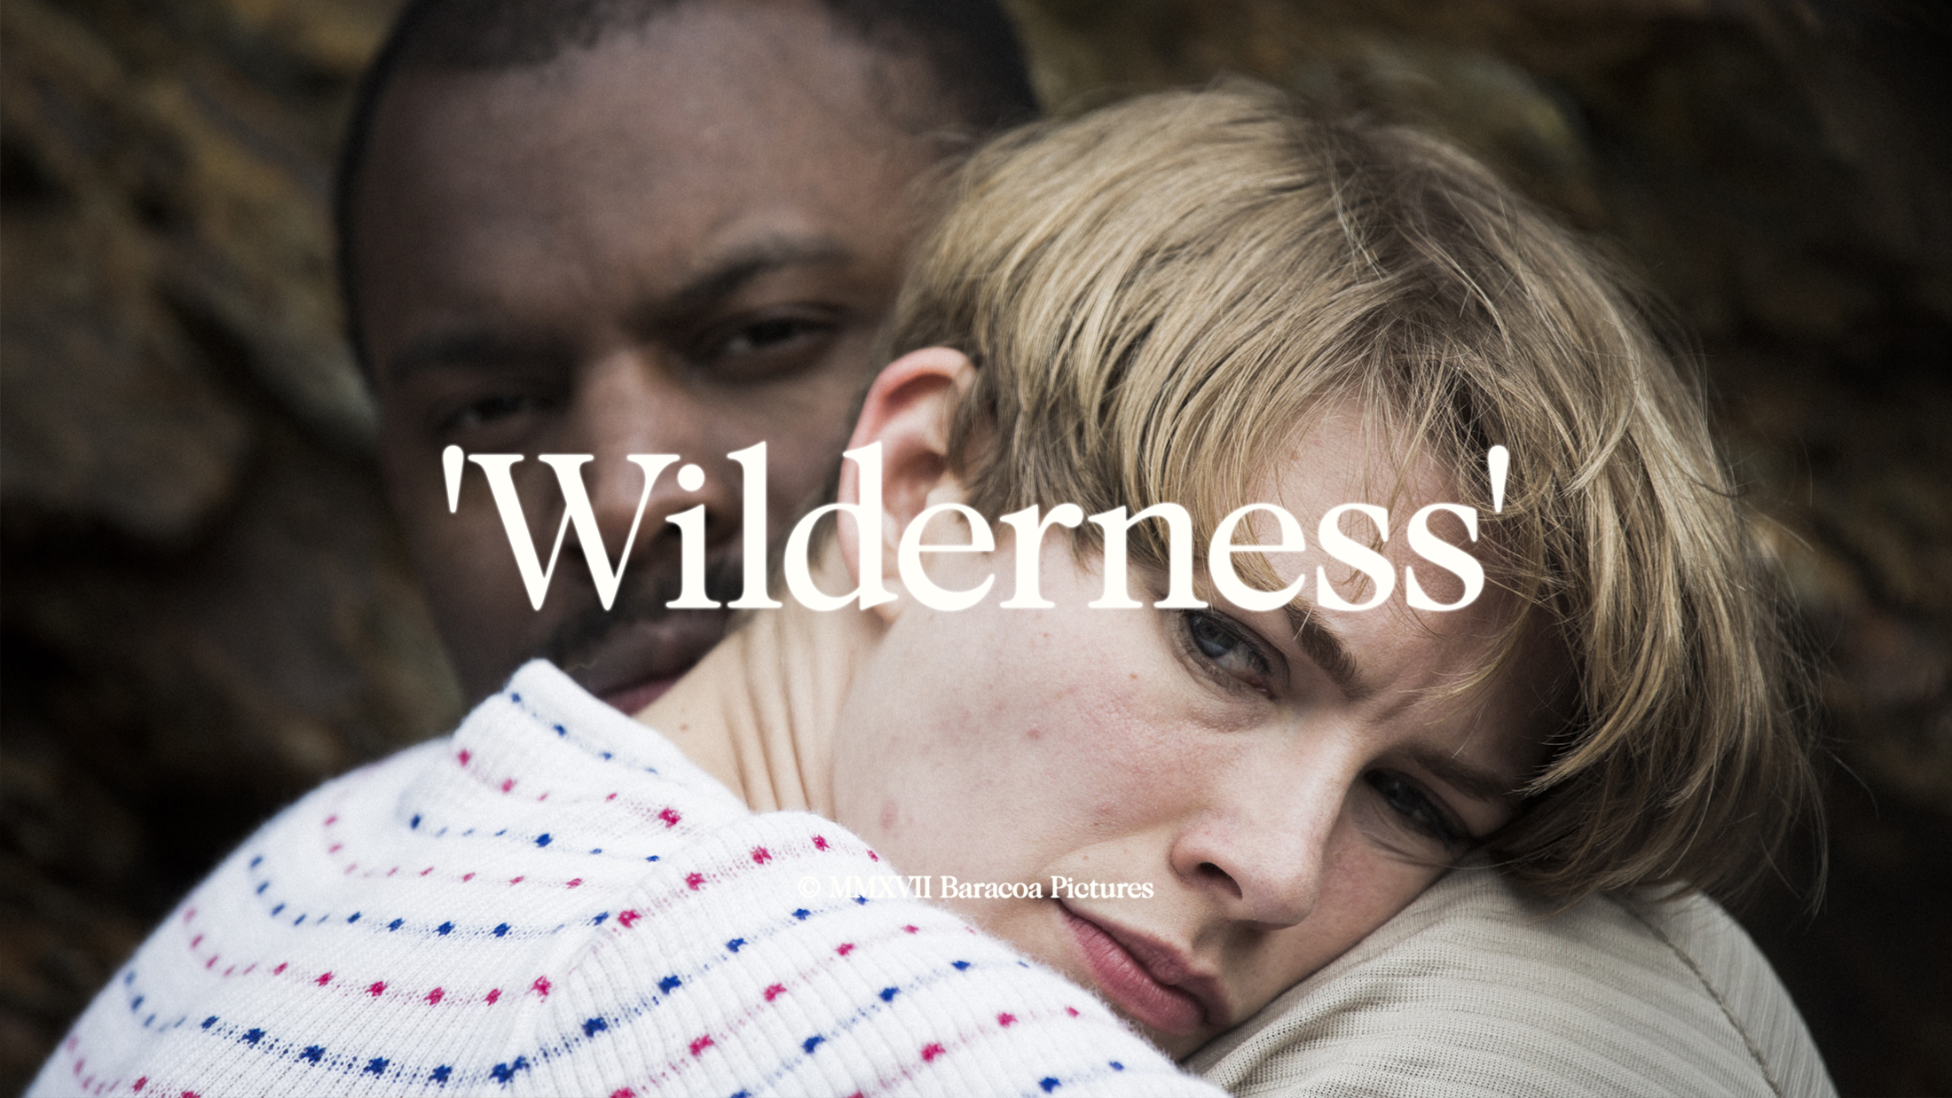
Developing a Commercial Film Production Ecosystem in Academia with Pedagogy at Its Heart
Dr. Neil Fox
Notes:
Image Link - https://www.chicagotribune.com/entertainment/movies/michael-phillips/sc-mov-ending-things-netflix-review-0827-20200827-fro2svuh5jevvk7ybedqang44i-story.html
Film – I’m Thinking Of Ending Things (Kaufman, 2019)

Slide 2
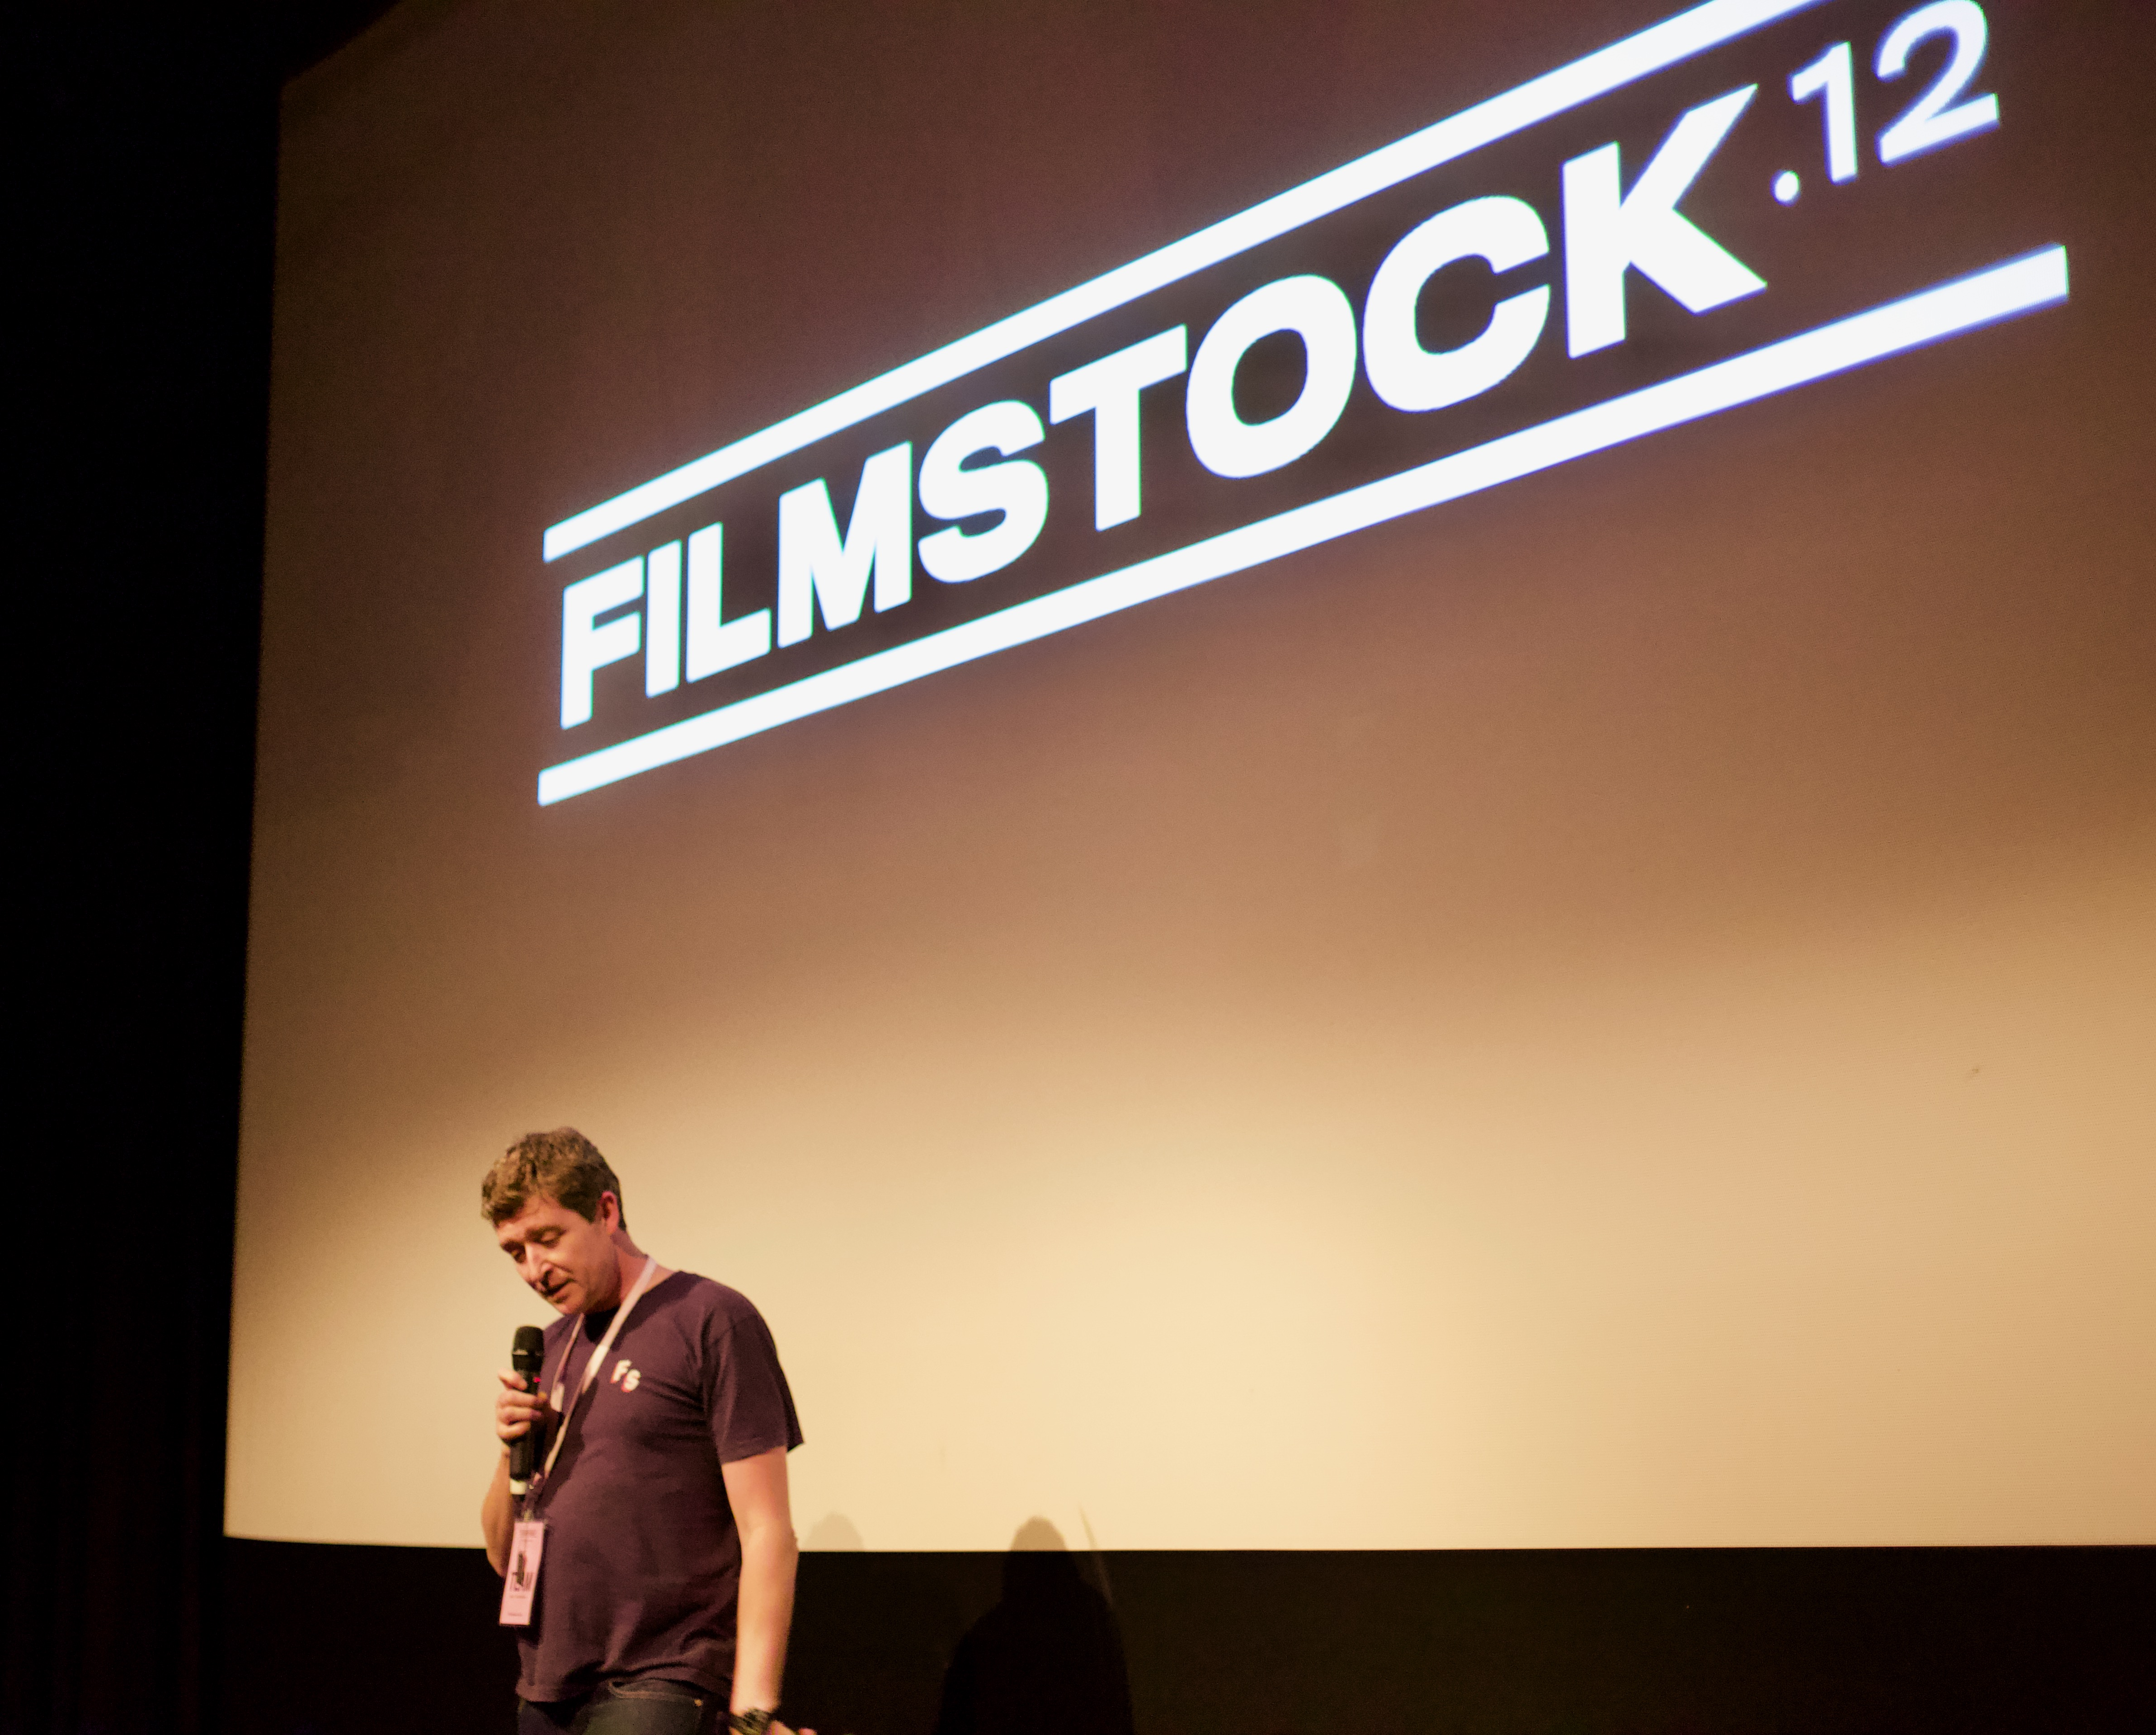
A Bit About Me…
Notes:
Photo Credit: Mark Wooldridge (2019). Used With Permission.

Slide 3

Sound/Image Cinema Lab
Support For Industry –
Funding, Resources, Labour (Student, Staff, Graduate)
Interventions in –
independent/
microbudget sector.
Notes:
Image link - https://kellyleeowens.bandcamp.com/album/inner-song

Slide 4
Sound/Image Cinema Lab
Active in Film Industry Engagement since 2010
9 Features and 5 Shorts (produced or co-produced) since 2015
2 Features (p/co-p) nearing completion
5 Shorts (p/co-p) nearing completion
1 Feature (p/co-p) shooting Spring 2021
Notes:
Image link - https://kellyleeowens.bandcamp.com/album/inner-song

Slide 5
Sound/Image Cinema Lab
Pedagogy
Notes:
Image link - https://kellyleeowens.bandcamp.com/album/inner-song

Slide 6
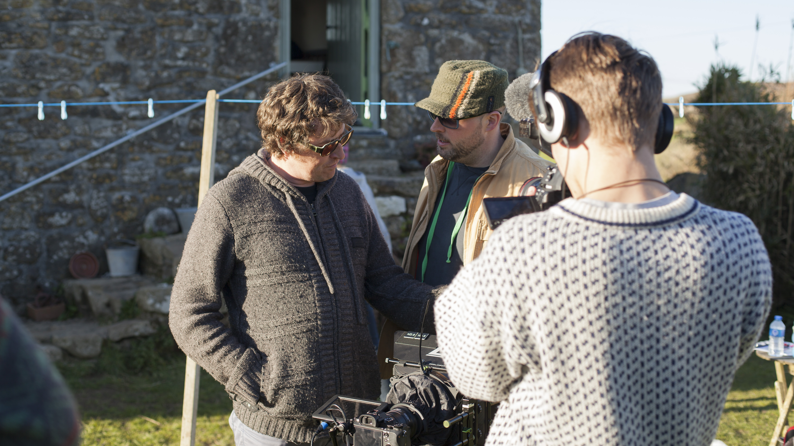
Case Study 1 – ‘Wilderness’ (2016/17)
Funding, Student crew, Staff crew, Resources, Behind The Scenes film shot by students
Notes:
Image - https://www.nytimes.com/2020/03/03/movies/first-cow-review.html
Film – First Cow (Reichardt, 2019)

Slide 7
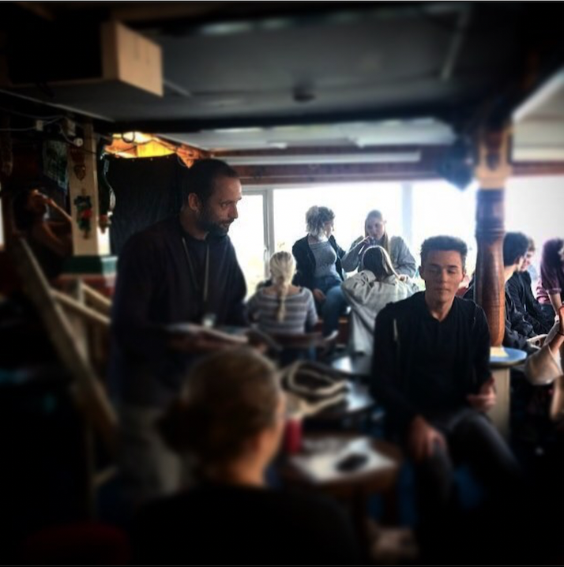
Case Study 2 – Bait (2018/19)
Funding, Student crew, Graduate Crew, Staff crew, Resources, Behind The Scenes film shot by staff and students
Notes:
Image - https://www.nytimes.com/2020/03/03/movies/first-cow-review.html
Film – First Cow (Reichardt, 2019)

Slide 8
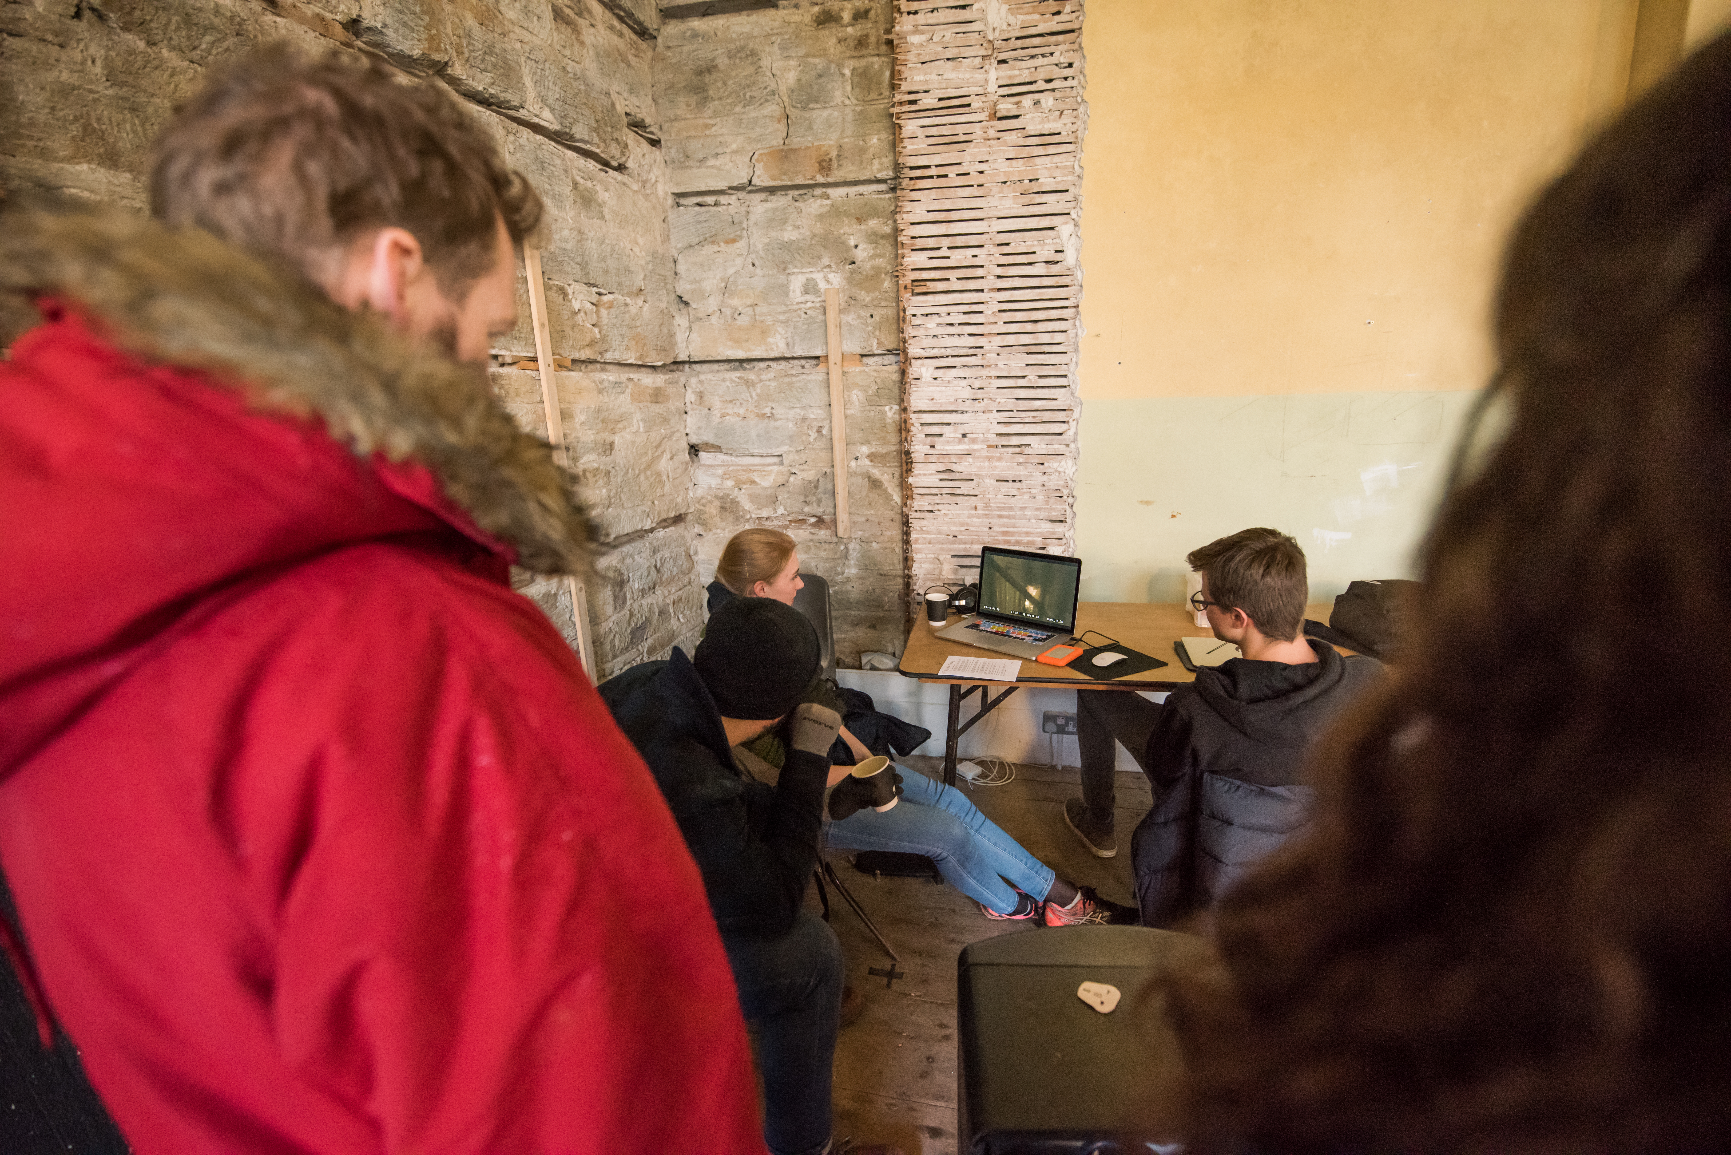
Case Study 3 – Backwoods (2018/19)
Funding, Student crew, Graduate Crew, Staff crew, Resources, Behind The Scenes images shot by students
Notes:
Image - https://www.nytimes.com/2020/03/03/movies/first-cow-review.html
Film – First Cow (Reichardt, 2019)

Slide 9
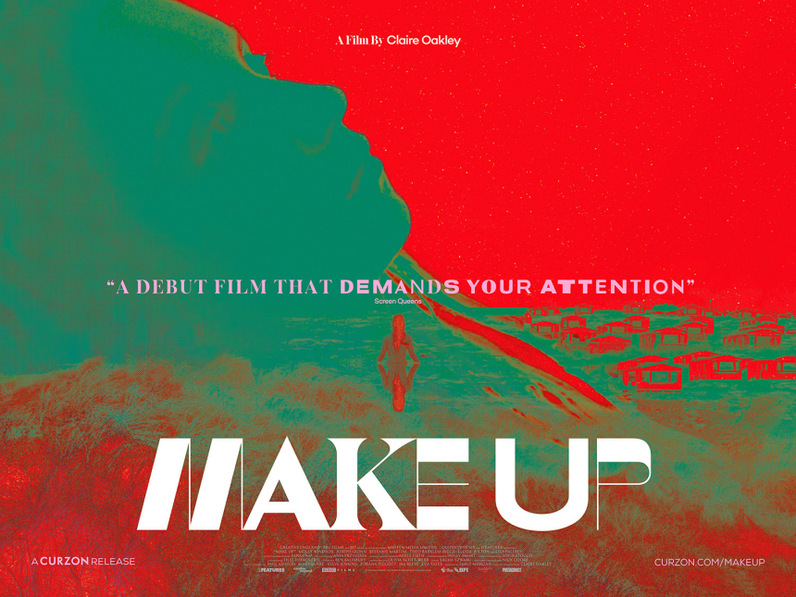
Case Study 3 – Make Up (2018/19)
Funding, Student crew, Graduate Crew, Staff crew, Resources, Behind The Scenes film shot by staff and students
Notes:
Image - https://www.nytimes.com/2020/03/03/movies/first-cow-review.html
Film – First Cow (Reichardt, 2019)

Slide 10
Sound/Image Cinema Lab
neil.fox@falmouth.ac.uk
@drneilfox (tw/IG)
Notes:
Screengrab – I Am Easy To Find (Mills, 2019)

